Slide 1
amazon
Project Presentation
by Yash Kumar

Slide 2

Unveiling Amazon's Tapestry
Engage with the retail giant, Amazon, as we unravel its story through the lens of our dataset —
an intricate tapestry of eCommerce insights waiting to be explored.

Slide 3
A Glimpse of Giant
From its 1994 bookstore roots, Amazon has exploded into a global online shopping titan, captivating over 310 million customers in 20+ countries. It dominates the e-commerce landscape, capturing a staggering 50% market share with its seemingly endless product selection. Think electronics, furniture, groceries – even clothes – all delivered straight to your doorstep with just a click. But Amazon's ambition doesn't stop there.
It's constantly innovating, from drone delivery trials to AI-powered recommendations, all aimed at making your shopping experience faster, easier, and more personalized. But one thing's for sure: Amazon's dominance in the e-commerce realm is undeniable, and its impact on the way we shop, and perhaps even live, is undeniable.

Slide 4

Problem Statement
You are working as a business analyst at Amazon, a company currently performing well.
The stakeholders wish to maintain this level of performance and seek improvement.
For this purpose, they want to devise new strategies.
You are part of a team exploring new ways to benefit customers, such as offering more discounts and Prime membership perks.
Could you suggest additional methods to identify and reward customers and enhance their shopping experience?

Slide 5

Let’s dive into the data !
Amazon’s E Commerce dataset of sales and products is huge.
My PowerBI sheet unveils the intricate insights & trends discussed in this presentation.
Data is prepared, and ready to be shipped.
So let’s just get into it!

Slide 6

Raw to Ready
We have cleaned and organized our raw dataset for better readability, operations & analysis.
First, we get the dataset from source then Transform data.
Then data is Loaded into the Power Query Editor for new measures and visualisation.
And now we are ready to pack…

Slide 7
What did we do ?
Formatted Table & Model view Created data in table view and checked for Model view for any cardinality if needed.
Fixed the inconsistent values Removed all Null values and Errors(except Reason column), corrected format of Order Date, ‘Delivey’ to ‘Delivery’.
Filled missing values Filled missing values with ‘None’ in Reason section
Generated new/hidden data Generated new column of Days to reach order from Order Date & Delivery Date and created Product hierarchy
Moved and Organised data Moved & Grouped columns accordingly to make data more readable and get necessary information for every page.

Slide 8
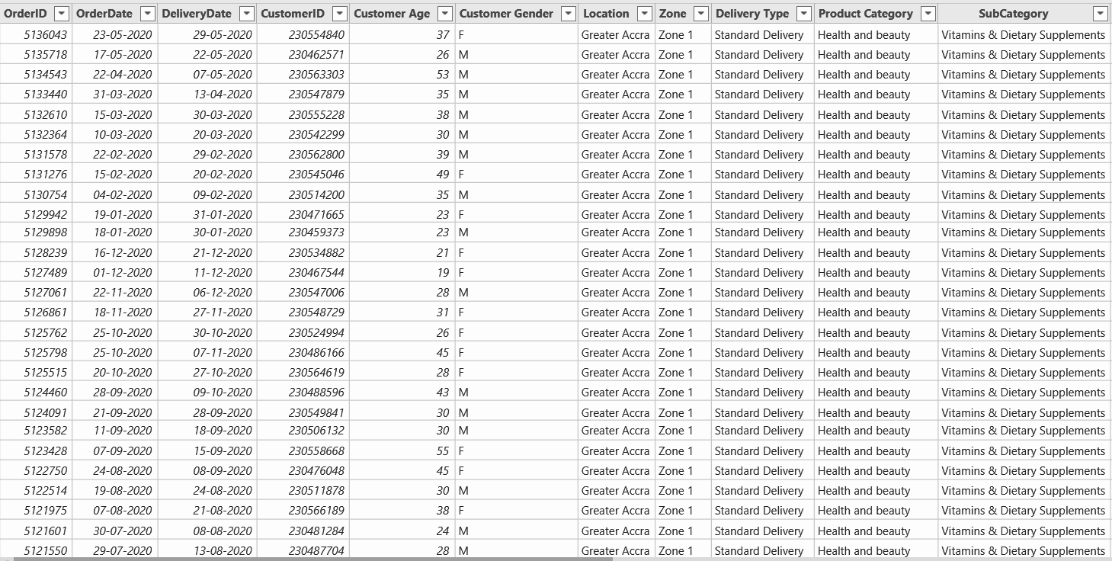
Table View

Slide 9
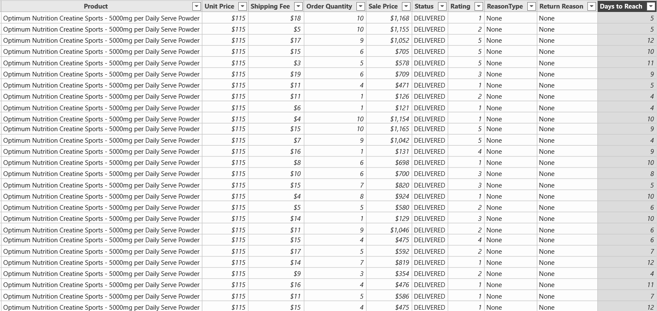
Table View

Slide 10

Cook by the Book
What do we do now ?
Created new queries and measures. Created multiple measures to get diverse insights like Total Revenue and Delivery Days, Field parameters.
Created visualization charts Created suitable visualization charts and tables from Queries.
By the book Created Main Tab, Product Tab, Product Table and suitable charts & visualisation for objective & subjective problems in document, with proper formatting. You can see them respectively in next slides.

Slide 11

Dress the Delivery
It is finally the time when you finish up the order and deliver to customer.
It’s the live Summary of the dataset in more visualising way for getting the gist of our data.
Formatted & Organised Visualisation charts
Presented the summarised information in organised manner.
Formatted for better readability & understanding.
Formatted while keeping theme of project intact and appealing.

Slide 12
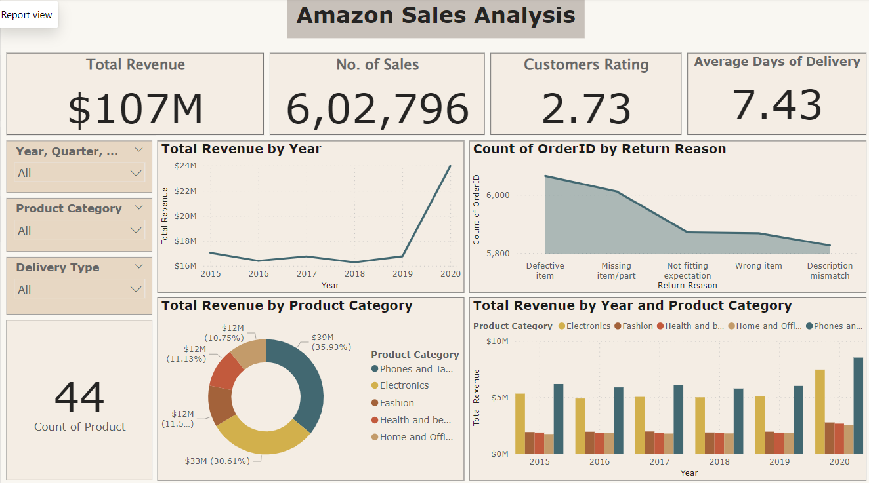

Slide 13
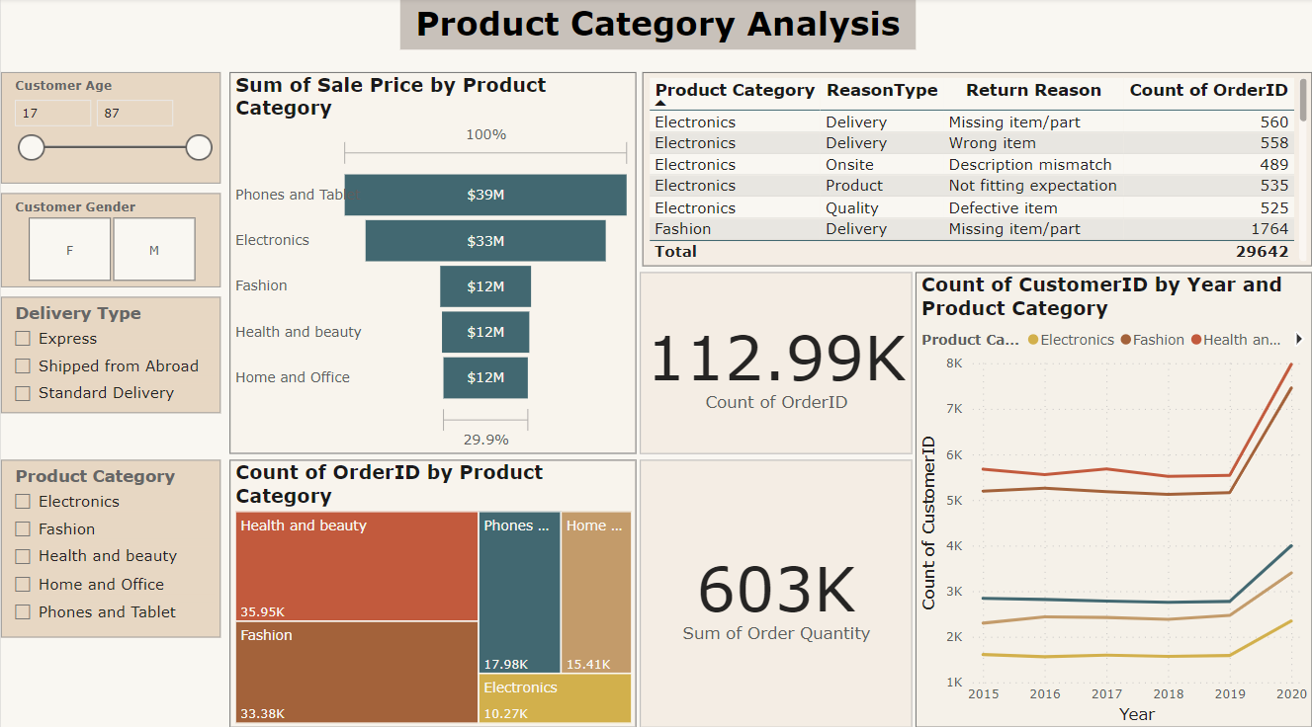

Slide 14
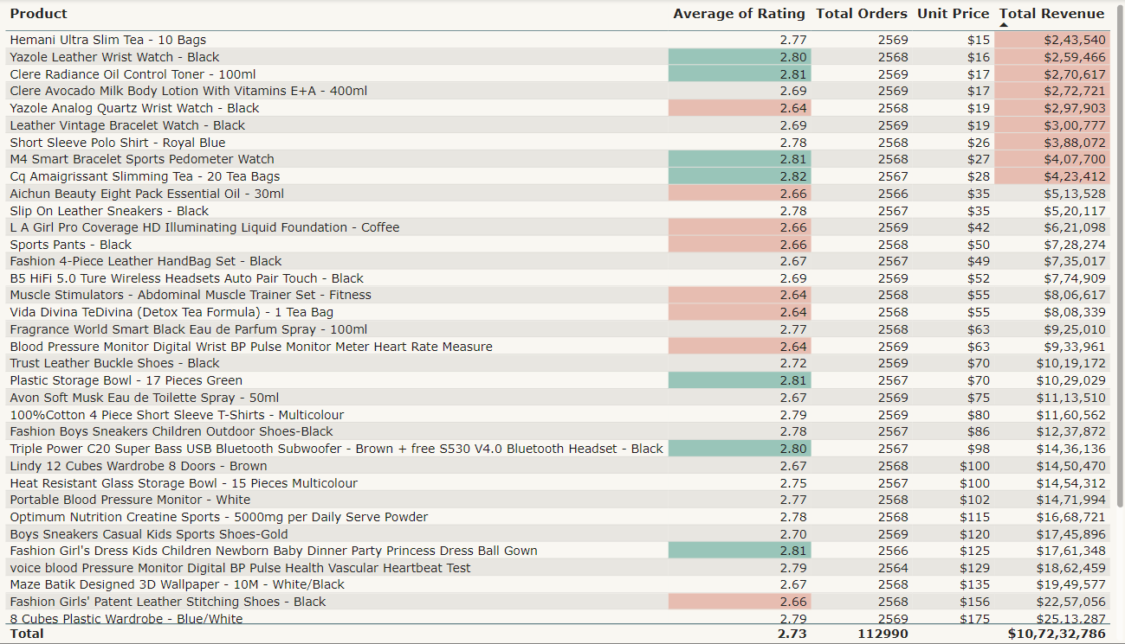

Slide 15

Statistical Insights
Total Revenue: $107M
Total no. of Sales: 603K
Total Orders: 113K
Orders Returned: 29.6K
Distinct Products: 44
Average Days of Delivery: 7.43
Average Customer Rating: 2.73

Slide 16
Key Insights
There was spike in number of unique customers of about 7000 new customers FY 2019-2020. Probably because of lockdown across the Globe.
Thus, more revenue of around $7.3M was generated fy 2020.
Most ordered Product Category: Health & Beauty (32% of total orders)
Most revenue generating Product Category: Phones & Tablets (36% of total revenue)
No strong correlation between Rating & Sales value Not all high rated products have generated good sales value. There are equally if not more, low rated products with good revenue generation.
Top 3 countries in revenue generating are: Ghana, United States and Sweden.
Three lowest performing months are: June, September and November.

Slide 17
Written Wrap
It’s better to have the analysis well documented in word as well for quick & specific query from whole dataset.
Created the Doc file Well documented word file with all the Objective & Subjective problems and its suitable answers with proper formatting.
My doc file: Amazon_Analysis

Slide 18
Learning & Improvement
Not every time you make a delivery is perfect, especially not the first. You learn along the way & keep getting better.
Concepts learned
Learned the working in Power BI, Report,Model and Table Views.
Proficiency in using formulas, measures, charts & visualisation in various conditions and all Panes.
Operation & formatting on raw dataset from scratch through Transform data.
Analytical thinking for creating meaningful Insights from data.
Creating cardinality and schemas.
Summarizing and writing up insights from data.
Documentation and presentation of work done on analysis of data.
Areas for Improvement
Diverse Data: Every field of work has different data unique in its way. So having more different datas to practice, the better.
Presentation: Takes a good long time thinking of presentation, its theme & formatting, that it gets delayed in execution and becomes hassel.

Slide 19
Conclusion & Suggestion
Comforting the customers tends to make them order frequently, this can be achieved by enhancing user experience.
Some higher rated products generate low revenue, so work is needed around the marketing and branding of them.
Advertisement in other countries with lower revenue generation should be considered.
Special monthly events or programs must be organized to lift up lower performing months in sales.
All Strategies must be formed to connect with customer at personalised level with integrity. These are crucial keys for business growth.

Slide 20

Thank you for navigating the Amazon’s forest of data with me!
If you ever feel data fatigue, just click “Add to Cart" on a random dataset of your life —
your next order & analysis awaits!

Slide 21

th
nk
you

